Slide 1
Chapter 9
Dictionaries

Slide 2
Basic Terms
Keys: variables that are used to call in Values
Values: variables that get called in by Keys

Slide 3

Lists vs Dictionaries
Organized according to the order
Indexes have to be integers
Order of values work as keys
[ a, b, c ]
List

Slide 4

Lists vs Dictionaries
Dictionary
Organized according to keys and values
Indexes can be of any type
{ key1: val1, key2:val2}
Only one value per key

Slide 5
How to use a Dictionary
Adding new Key & Value
Calling values using key
Modifying the dictionary

Slide 6


How to use a Dictionary
Adding new Key & Value
Creating and empty dictionary
Adding new keys and values (similar to append() of lists)

Slide 7

How to use a Dictionary
Calling values using key (indexing)
In lists, the order of variables work as keys
Name_of_dict[ ‘key’ ] == val

Slide 8

How to use a Dictionary
Modifying a dictionary
We can simply modify our dictionaries by rewriting the keys and values

Slide 9
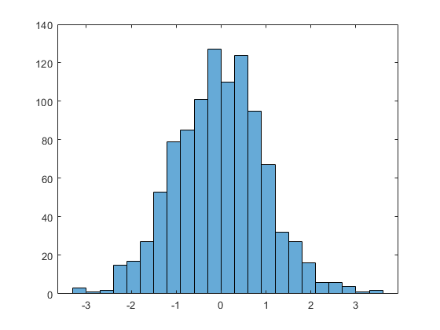
Creating a Histogram
Histogram : graph used to see the distribution of data
Need to count how many times a certain variable appears

Slide 10
Counting Data
Using dictionaries, it is possible to get the frequency of data
If a certain data appears for the first time, we can make a key for that type of data
If the data appears again, we can add 1 to the value assigned to the data

Slide 11
cow
dog
chicken
dog
dog
pig
pig

Slide 12
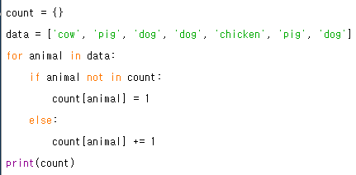
Creating an empty dict
For each variable in data
If that animal is not in the list yet
Make that animal a key with the value of 1
If it is in the list
Add 1 to the value of that key(animal)

Slide 13

The get( ) method
The lines of code for counting is used too many times
So, people made a method to do it quickly

Slide 14
The get( ) method
for animal in data:
count[animal] = count.get(animal, 0) +1
get(name of key , default value) +1

Slide 15
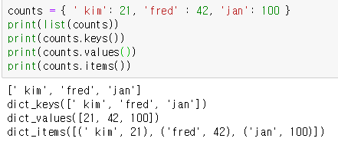
Retrieving lists of Keys and Values
We can choose if we are going to print keys, values, or both

Slide 16



‘for’ loop for dictionaries
for loop reads keys and values separately

Slide 17
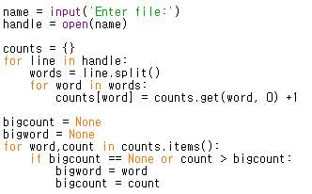

Slide 18
Try Yourself
Write the codes from the previous screen
Create a textfile, whatever the content is, and try to see which word most frequently appears

